Slide 1
Functional Dependencies and Normalization Part-2

Slide 2
Boyce and Codd Normal Form (BCNF)
This normal form is also referred as 3.5 normal forms. BCNF is an extension of Third Normal Form on strict terms. This normal form meets all the requirement of 3NF.
Boyce-Codd Normal Form (BCNF states that −
For any non-trivial functional dependency, X → A, X must be a super-key.
In previous example, Stu_ID is the super-key in the relation Student_Detail.
Zip is the super-key in the relation ZipCodes. So,
Stu_ID → Stu_Name, Zip
and
Zip → City
Which confirms that both the relations are in BCNF.
Any table is said to be in BCNF, if its candidate keys do not have any partial dependency on the other attributes. i.e.; in any table with (x, y, z) columns, if (x, y)->z and z->x then it's a violation of BCNF. If (x, y) are composite keys and (x, y)->z, then there should not be any reverse dependency, directly or partially.

Slide 3
In the above 3NF example, Stu_ID is the Primary key in Student_detail table and ZIP is the primary key in the ZipCodes table. There is no other key column in each of the tables which determines the functional dependency. Hence it's in BCNF form.
That is, with Stu_ID, we can retrieve Stu_NAME and ZIP from Student_detail table.
Similarly, with ZIP value, we can retrieve CITY from ZipCodes table.

Slide 4
Example (For Practice)
Let us consider another example - consider each student who has taken major subjects has different advisory lecturers. Each student will have different advisory lecturers for same Subjects. There exists following relationship, which is violation of BCNF.
(STUDENT_ID, MAJOR_SUBJECT) -> ADVISORY_LECTURER
ADVISORY_LECTURER -> MAJOR_SUBJECT
i.e. Major_Subject which is a part of composite candidate key is determined by non-key attribute of the same table, which is against the rule.
Below table will have all the anomalies too. If we delete any student from below table, it deletes lecturer's information too. If we add any new lecturer/student to the database, it needs other related information also. Also, if we update subject for any student, his lecturer info also needs to be changed, else it will lead to inconsistency.

Slide 5
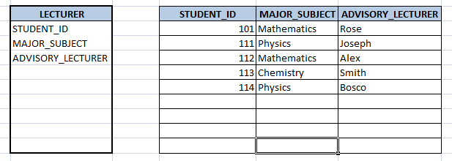

Slide 6
Hence we need to decompose the table so that it eliminates such relationship. Now in the new tables below, there are no inter-dependent composite keys (moreover, there is no composite key in both the tables).
If we need to add/update/delete any lecturer, we can directly insert record into STUDENT_ADVISOR table, without affecting STUDENT_MAJOR table. If we need to insert/update/delete any subject for a student, then we can directly do it on STUDENT_MAJOR table, without affecting STUDENT_ADVISOR table.
When we have both advisor as well as major subject information, then we can directly add/update both the tables.
Hence we have eliminated all the anomalies in the database.

Slide 7
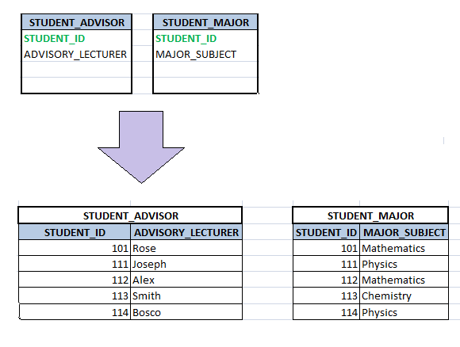

Slide 8
Fourth Normal Form (4NF)
In the fourth normal form:
It should meet all the requirement of 3NF.
Attribute of one or more rows in the table should not result in more than one rows of the same table leading to multi-valued dependencies
To understand it clearly, consider a table with Subject, Lecturer who teaches each subject and recommended Books for each subject.
When query…

Slide 9
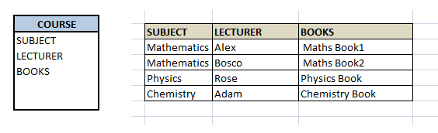

Slide 10
If we observe the data in the table above, it satisfies 3NF. But LECTURER and BOOKS are two independent entities here. There is no relationship between Lecturer and Books. In the above example, either Alex or Bosco can teach Mathematics. For Mathematics subject, student can refer either 'Maths Book1' or 'Maths Book2'. i.e.;
SUBJECT --> LECTURER
SUBJECT-->BOOKS
This is a multivalued dependency on SUBJECT. If we need to select both lecturer and books recommended for any of the subject, it will show up (lecturer, books) combination, which implies lecturer who recommends which book. This is not correct.

Slide 11
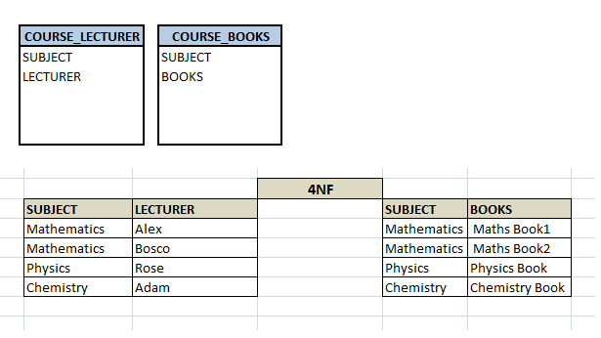
To eliminate this dependency, we divide the table into two as below:
Now if we want to know the lecturer names and books recommended for any of the subject, we will fire two independent queries. Hence it removes the multi-valued dependency and confusion around the data. Thus the table is in 4NF.

Slide 12
Fifth Normal Form (5NF)
A database is said to be in 5NF, if and only if,
It's in 4NF
If we can decompose table further to eliminate redundancy and anomaly, and when we re-join the decomposed tables by means of candidate keys, we should not be losing the original data or any new record set should not arise. In simple words, joining two or more decomposed table should neither lose records nor create new records.
Consider an example of different Subjects taught by different lecturers and the lecturers taking classes for different semesters.
Note: Consider that Semester1 has Mathematics, Physics and Chemistry and Semester2 has only Physics in its academic year.

Slide 13
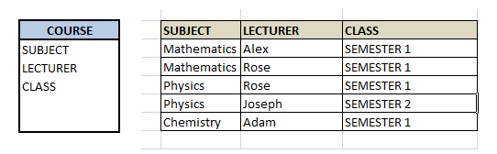

Slide 14
In above table, Rose takes both Mathematics and Physics class for Semester 1, but she does not take Physics class for Semester 2. In this case, combination of all these 3 fields is required to identify a valid data. If we want to add a new class - Semester3 but do not know which Subject and who will be taking that subject. We would be simply inserting a new entry with Class as Semester3 and leaving Lecturer and subject as NULL. But it's not a good to have such entries. Moreover, all the three columns together act as a primary key, we cannot leave other two columns blank.
Hence we have to decompose the table in such a way that it satisfies all the rules till 4NF and when join them by using keys, it should give correct record. Here, we can represent each lecturer's Subject area and their classes in a better way. We can divide above table into three –
(SUBJECT, LECTURER), (LECTURER, CLASS), (SUBJECT, CLASS)

Slide 15
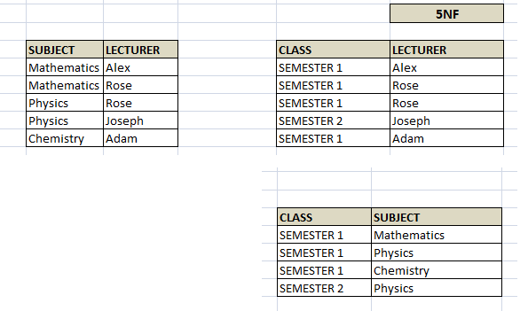

Slide 16
Now, each of combinations is in three different tables. If we need to identify who is teaching which subject to which semester, we need join the keys of each table and get the result.
Query: who teaches Physics to Semester1,
we would be selecting Physics and Semester1 from table 3 above, join with table1 using Subject to filter out the lecturer names. Then join with table2 using Lecturer to get correct lecturer name.
That is we joined key columns of each table to get the correct data. Hence there is no lose or new data - satisfying 5NF condition.

Slide 17
select t3.Class, t3.Subject, t1.Lecturer
from TABLE3 t3, TABLE2 t2, TABLE1 t1,
where t3.Class = 'SEMESTER1' and t3.SUBJECT= 'PHYSICS'
and t3.Subject = t1.Subject
and t3.Class = t2.Class
and t1.Lecturer = t2.Lecturer;

Slide 18
END of Part-2

Slide 19
Sources
www.studytonight.com/dbms/database-normalization.php
www.tutorialspoint.com/dbms/pdf/database_normalization.pdf
www.tutorialspoint.com/dbms/dbms_storage_system.htm
www.tutorialcup.com/dbms/boyce-codd-normal-form.htm
Other Books.

